Slide 1
Keerthi Sales Insight Project
File created on: 4/5/2023 10:02:43 PM

Slide 2
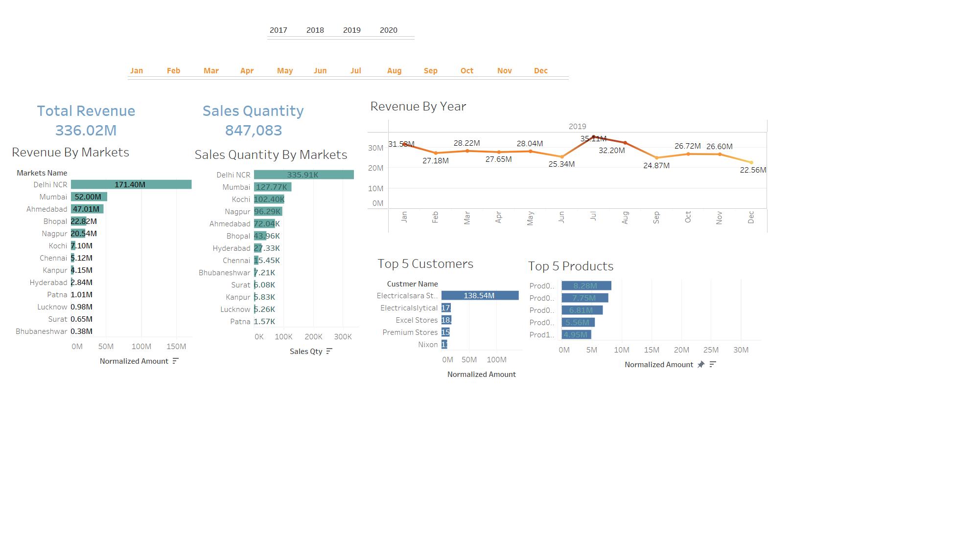

Slide 3
